Slide 1
Gustav Holst
Mars
Primary classroom lesson plan
Written by
Rachel Leach
Notes:
For:
Key Stage 2 in England and Wales
Second Level, P5-P7 in Scotland
Key Stage 1/Key Stage 2 in Northern Ireland

Slide 2
Lesson outcomes
After this lesson, pupils will be able to:
• listen and reflect on a piece of orchestral music
• learn musical motifs from Holst’s Mars and structure them into a piece
• invent their own musical motifs and structure them into a piece
• perform as an ensemble
• learn musical language appropriate to the task
Notes:
Resources required
Paper and pens
Classroom percussion instruments and any other instruments that your children might be learning
This scheme of work is plotted out over six lessons. Feel free to adapt it to suit your children and the resources you have available.
The six lessons at a glance
Lesson 1:
Activities: Listen and describe a piece of music
Watch the orchestral performance and discuss
Use the music as stimulus for artwork
Curriculum link: Listen with attention to detail and recall sounds with increasing aural memory
Appreciate and understand a wide range of high-quality live and recorded music drawn from different traditions and from great composers and musicians
Develop an understanding of the history of music
Lesson 2:
Activities: Learn two asymmetrical ostinatos
Orchestrate them and use them to create a crescendo
Curriculum link: Listen with attention to detail and recall sounds with increasing aural memory
Play and perform in solo and ensemble contexts, using voices and playing musical instruments with increasing accuracy, fluency, control and expression
Lesson 3:
Activities: Invent new ostinatos in a march style
Choose appropriate instruments and work in groups to structure these ideas
Curriculum link: Listen with attention to detail and recall sounds with increasing aural memory
Improvise and compose music for a range of purposes using the interrelated dimensions of music
Play and perform in solo and ensemble contexts, using voices and playing musical instruments with increasing accuracy, fluency, control and expression
Lesson 4:
Activities: Structure two pieces of music into one larger piece
Curriculum link: Improvise and compose music for a range of purposes using the interrelated dimensions of music
Play and perform in solo and ensemble contexts, using voices and playing musical instruments with increasing accuracy, fluency, control and expression
Lesson 5:
Activities: Follow a diagram (or listen and invent a diagram) to create Holst’s coda
Structure all ideas so far into one big piece and perform it to an audience
Use technical terminology where appropriate
Curriculum link: Improvise and compose music for a range of purposes using the interrelated dimensions of music
Play and perform in solo and ensemble contexts, using voices and playing musical instruments with increasing accuracy, fluency, control and expression
Lesson 6:
Activities: Create musical motifs to describe a new planet
Structure these ideas into a piece
Curriculum link: Play and perform in solo and ensemble contexts, using their voices and playing musical instruments with increasing accuracy, fluency, control and expression
Improvise and compose music for a range of purposes using the interrelated dimensions of music

Slide 3
Curriculum checklist
Learners will:
• play and perform in ensemble contexts, using voices and playing musical instruments
• improvise and compose music for a range of purposes using the interrelated dimensions of music
• listen with attention to detail and recall sounds with increasing aural memory
Notes:
Resources required
Paper and pens
Classroom percussion instruments and any other instruments that your children might be learning
This scheme of work is plotted out over six lessons. Feel free to adapt it to suit your children and the resources you have available.
The six lessons at a glance
Lesson 1:
Activities: Listen and describe a piece of music
Watch the orchestral performance and discuss
Use the music as stimulus for artwork
Curriculum link: Listen with attention to detail and recall sounds with increasing aural memory
Appreciate and understand a wide range of high-quality live and recorded music drawn from different traditions and from great composers and musicians
Develop an understanding of the history of music
Lesson 2:
Activities: Learn two asymmetrical ostinatos
Orchestrate them and use them to create a crescendo
Curriculum link: Listen with attention to detail and recall sounds with increasing aural memory
Play and perform in solo and ensemble contexts, using voices and playing musical instruments with increasing accuracy, fluency, control and expression
Lesson 3:
Activities: Invent new ostinatos in a march style
Choose appropriate instruments and work in groups to structure these ideas
Curriculum link: Listen with attention to detail and recall sounds with increasing aural memory
Improvise and compose music for a range of purposes using the interrelated dimensions of music
Play and perform in solo and ensemble contexts, using voices and playing musical instruments with increasing accuracy, fluency, control and expression
Lesson 4:
Activities: Structure two pieces of music into one larger piece
Curriculum link: Improvise and compose music for a range of purposes using the interrelated dimensions of music
Play and perform in solo and ensemble contexts, using voices and playing musical instruments with increasing accuracy, fluency, control and expression
Lesson 5:
Activities: Follow a diagram (or listen and invent a diagram) to create Holst’s coda
Structure all ideas so far into one big piece and perform it to an audience
Use technical terminology where appropriate
Curriculum link: Improvise and compose music for a range of purposes using the interrelated dimensions of music
Play and perform in solo and ensemble contexts, using voices and playing musical instruments with increasing accuracy, fluency, control and expression
Lesson 6:
Activities: Create musical motifs to describe a new planet
Structure these ideas into a piece
Curriculum link: Play and perform in solo and ensemble contexts, using their voices and playing musical instruments with increasing accuracy, fluency, control and expression
Improvise and compose music for a range of purposes using the interrelated dimensions of music

Slide 4
Glossary of music terms
Term | Definition
Coda | another word for ending
Crescendo | gradually getting louder
Motif | a small musical idea
Ostinato | a repeating pattern
Pitched percussion | percussion instruments that can play different pitches – xylophones, glockenspiels, chime bars etc.
Pulse | the steady ‘’beat’ underneath much music made up of notes of the same length (like a ticking clock or steady footsteps)
Unpitched percussion | percussion instruments that can only make a limited number of sounds – drums, shakers woodblocks, tambourine etc.

Slide 5
Lesson 1
Watching and listening
Copyright Rachel Leach & BBC
Notes:
Lesson 1:
Activities: Listen and describe a piece of music
Watch the orchestral performance and discuss
Use the music as stimulus for artwork
Curriculum link: Listen with attention to detail and recall sounds with increasing aural memory
Appreciate and understand a wide range of high-quality live and recorded music drawn from different traditions and from great composers and musicians
Develop an understanding of the history of music

Slide 6
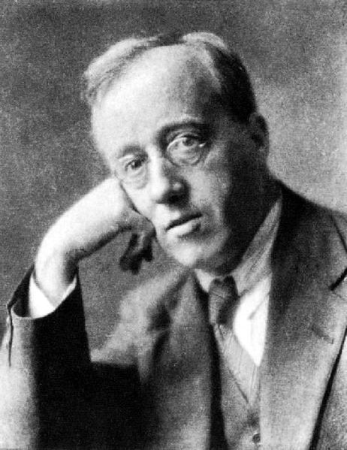
Background – the composer
Gustav Holst (1874 - 1934)
British composer
Eccentric character - fascinated by space, astrology, alternative faiths, meditation and vegetarianism

Slide 7
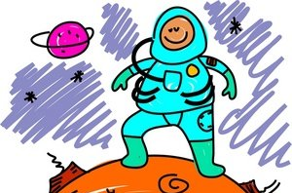
Background – the music
‘Mars’ from The Planets Suite
    Written in 1918 for very large orchestra
    The full suite describes 7 planets (no Earth)
    Holst was particularly interested in the ‘character’ of each planet rather than its science

Slide 8
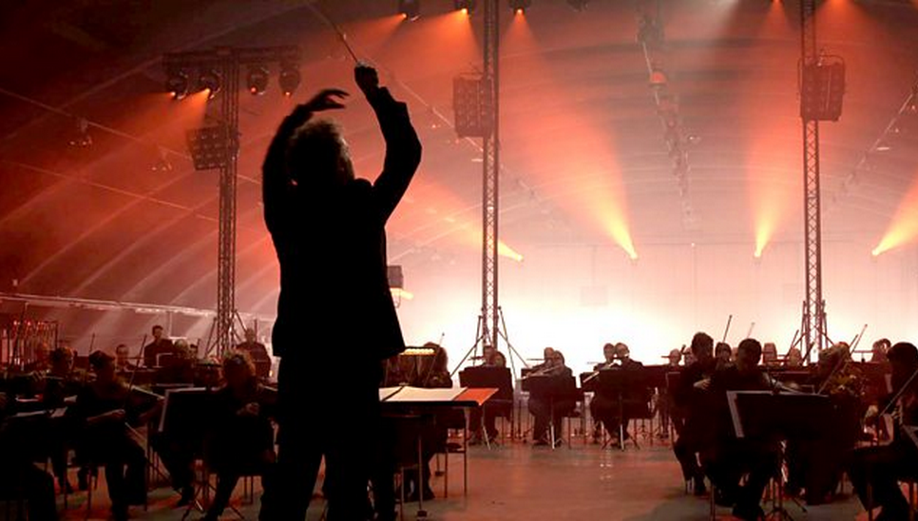
Watch the orchestral performance
https://www.bbc.co.uk/programmes/p02b14ld
Notes:
LESSON 1:
Prepare your class
Explain to your class that you are going to begin a 6-week music project focusing on a fantastic piece of music by a composer called Gustav Holst. Explain further that Holst wrote music to describe the planets.
Watch the orchestral performance film of Mars from the BBC 10 Pieces website (note that this is a shorter version than the original and so it is perfect for use in the classroom)
Ask your children which planet they think it might be describing and after discussing their ideas reveal that it is mars. Holst called mars the Bringer of War.
At this point in the project you may also like to watch the introduction to Mars with Dick and Dom – also on the BBC 10 Pieces website
Listening task. Give out paper and coloured pens to your class. As you watch and listen again ask them to write down answers to the following questions –
If the music was describing a colour, which colour would it be?
If the music was describing a shape, which shape would it be?
If the music was describing a line, would it be curvy and smooth or spiky and jagged?
Encourage your children to write just one or two words for each answer, so they should have a list like this –
Purple
A triangle
Spiky
Explain that the music could be describing a spaceship travelling to mars. As you listen again (perhaps several times), ask your class to draw the spaceship using the music as inspiration but also the short list they have made above. (i.e. this one would be purple, triangular and spiky)
Finally, discuss their artwork and show some to the class. Tell them that all of their efforts are correct because it is what they imagined whilst they listened.

Slide 9
Answer in one word
If the music was describing a colour, which colour would it be?
If the music was describing a shape, which shape would it be?
If the music was describing a line, would it be curvy and smooth or spiky and jagged?
Notes:
LESSON 1:
Prepare your class
Explain to your class that you are going to begin a 6-week music project focusing on a fantastic piece of music by a composer called Gustav Holst. Explain further that Holst wrote music to describe the planets.
Watch the orchestral performance film of Mars from the BBC 10 Pieces website (note that this is a shorter version than the original and so it is perfect for use in the classroom)
Ask your children which planet they think it might be describing and after discussing their ideas reveal that it is mars. Holst called mars the Bringer of War.
At this point in the project you may also like to watch the introduction to Mars with Dick and Dom – also on the BBC 10 Pieces website
Listening task. Give out paper and coloured pens to your class. As you watch and listen again ask them to write down answers to the following questions –
If the music was describing a colour, which colour would it be?
If the music was describing a shape, which shape would it be?
If the music was describing a line, would it be curvy and smooth or spiky and jagged?
Encourage your children to write just one or two words for each answer, so they should have a list like this –
Purple
A triangle
Spiky
Explain that the music could be describing a spaceship travelling to mars. As you listen again (perhaps several times), ask your class to draw the spaceship using the music as inspiration but also the short list they have made above. (i.e. this one would be purple, triangular and spiky)
Finally, discuss their artwork and show some to the class. Tell them that all of their efforts are correct because it is what they imagined whilst they listened.

Slide 10

Imagine and draw
Notes:
LESSON 1:
Prepare your class
Explain to your class that you are going to begin a 6-week music project focusing on a fantastic piece of music by a composer called Gustav Holst. Explain further that Holst wrote music to describe the planets.
Watch the orchestral performance film of Mars from the BBC 10 Pieces website (note that this is a shorter version than the original and so it is perfect for use in the classroom)
Ask your children which planet they think it might be describing and after discussing their ideas reveal that it is mars. Holst called mars the Bringer of War.
At this point in the project you may also like to watch the introduction to Mars with Dick and Dom – also on the BBC 10 Pieces website
Listening task. Give out paper and coloured pens to your class. As you watch and listen again ask them to write down answers to the following questions –
If the music was describing a colour, which colour would it be?
If the music was describing a shape, which shape would it be?
If the music was describing a line, would it be curvy and smooth or spiky and jagged?
Encourage your children to write just one or two words for each answer, so they should have a list like this –
Purple
A triangle
Spiky
Explain that the music could be describing a spaceship travelling to mars. As you listen again (perhaps several times), ask your class to draw the spaceship using the music as inspiration but also the short list they have made above. (i.e. this one would be purple, triangular and spiky)
Finally, discuss their artwork and show some to the class. Tell them that all of their efforts are correct because it is what they imagined whilst they listened.

Slide 11
Lesson 2
Five-beat repeating patterns
(ostinatos)
Copyright Rachel Leach & BBC
Notes:
Lesson 2:
Activities: Learn two asymmetrical ostinatos
Orchestrate them and use them to create a crescendo
Curriculum link: Listen with attention to detail and recall sounds with increasing aural memory
Play and perform in solo and ensemble contexts, using voices and playing musical instruments with increasing accuracy, fluency, control and expression

Slide 12
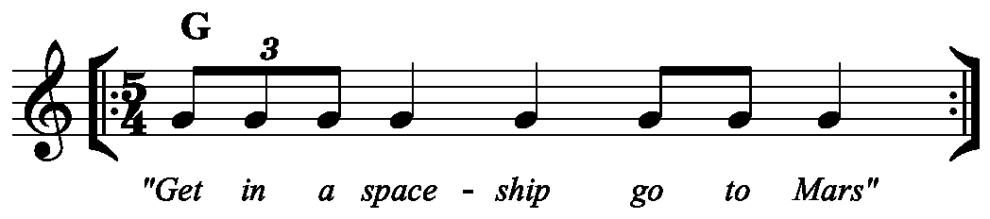

Can you learn this rhythm?
Notes:
LESSON 2:
Warm-up. Ask your class to sit in a circle and lead a quick body percussion warm-up such as passing the clap around or clapping patterns for the class to copy back
Teach everyone the rhythm.
Begin by encouraging your class to say the words over and over, this will help with memory. Eventually take the words away and just clap
Ask a volunteer to come forward and play the pattern on a percussion instrument of their choice (if they choose a xylophone, direct them towards the note G)
Teach the next pattern
This is easier than it looks, simply count to 8, 2 and 10 over and over and then encourage everyone to clap on each 1
Split your circle into two quick groups, start each group on one of the above ideas and layer them up until both rhythms are going at once. Explain that the technical term for a repeating rhythmic pattern is an ostinato
Demonstrate how these patterns could work on instruments:
‘get in a spaceship’ should be unpitched, or stick to one pitch – G
8, 2, 10 should leap upwards and then slip downwards. However, you could make it work with whatever you have available or stick with body percussion
Split into two teams and challenge each team to play one of these rhythms on their chosen instruments
Bring the groups back together and listen to their pieces. Ask them to try performing at the same time.
Finally, if you have time, listen and watch the opening of Mars on the website (just the first minute or so). Ask your children to identify what happens to the volume. Hopefully they will say it gets louder. Tell them that the technical term for music gradually getting louder is crescendo and challenge them to play their patterns together one more time and add in a crescendo

Slide 13
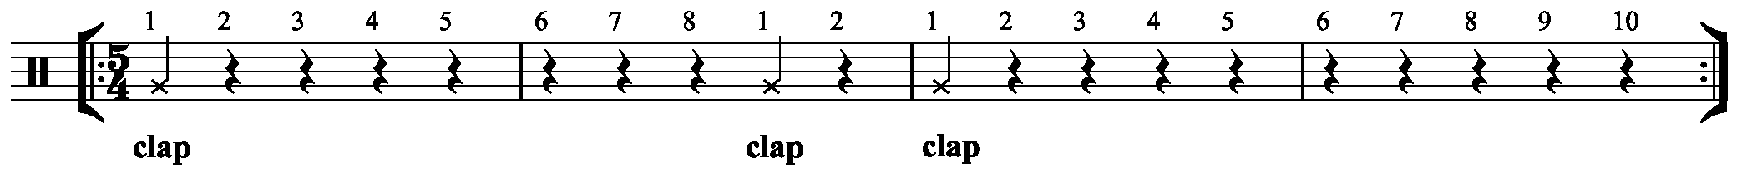
What about this one?
Notes:
LESSON 2:
Warm-up. Ask your class to sit in a circle and lead a quick body percussion warm-up such as passing the clap around or clapping patterns for the class to copy back
Teach everyone the rhythm.
Begin by encouraging your class to say the words over and over, this will help with memory. Eventually take the words away and just clap
Ask a volunteer to come forward and play the pattern on a percussion instrument of their choice (if they choose a xylophone, direct them towards the note G)
Teach the next pattern
This is easier than it looks, simply count to 8, 2 and 10 over and over and then encourage everyone to clap on each 1
Split your circle into two quick groups, start each group on one of the above ideas and layer them up until both rhythms are going at once. Explain that the technical term for a repeating rhythmic pattern is an ostinato
Demonstrate how these patterns could work on instruments:
‘get in a spaceship’ should be unpitched, or stick to one pitch – G
8, 2, 10 should leap upwards and then slip downwards. However, you could make it work with whatever you have available or stick with body percussion
Split into two teams and challenge each team to play one of these rhythms on their chosen instruments
Bring the groups back together and listen to their pieces. Ask them to try performing at the same time.
Finally, if you have time, listen and watch the opening of Mars on the website (just the first minute or so). Ask your children to identify what happens to the volume. Hopefully they will say it gets louder. Tell them that the technical term for music gradually getting louder is crescendo and challenge them to play their patterns together one more time and add in a crescendo

Slide 14

Ostinato
Notes:
LESSON 2:
Warm-up. Ask your class to sit in a circle and lead a quick body percussion warm-up such as passing the clap around or clapping patterns for the class to copy back
Teach everyone the rhythm.
Begin by encouraging your class to say the words over and over, this will help with memory. Eventually take the words away and just clap
Ask a volunteer to come forward and play the pattern on a percussion instrument of their choice (if they choose a xylophone, direct them towards the note G)
Teach the next pattern
This is easier than it looks, simply count to 8, 2 and 10 over and over and then encourage everyone to clap on each 1
Split your circle into two quick groups, start each group on one of the above ideas and layer them up until both rhythms are going at once. Explain that the technical term for a repeating rhythmic pattern is an ostinato
Demonstrate how these patterns could work on instruments:
‘get in a spaceship’ should be unpitched, or stick to one pitch – G
8, 2, 10 should leap upwards and then slip downwards. However, you could make it work with whatever you have available or stick with body percussion
Split into two teams and challenge each team to play one of these rhythms on their chosen instruments
Bring the groups back together and listen to their pieces. Ask them to try performing at the same time.
Finally, if you have time, listen and watch the opening of Mars on the website (just the first minute or so). Ask your children to identify what happens to the volume. Hopefully they will say it gets louder. Tell them that the technical term for music gradually getting louder is crescendo and challenge them to play their patterns together one more time and add in a crescendo

Slide 15
These patterns can work on instruments
Notes:
LESSON 2:
Warm-up. Ask your class to sit in a circle and lead a quick body percussion warm-up such as passing the clap around or clapping patterns for the class to copy back
Teach everyone the rhythm.
Begin by encouraging your class to say the words over and over, this will help with memory. Eventually take the words away and just clap
Ask a volunteer to come forward and play the pattern on a percussion instrument of their choice (if they choose a xylophone, direct them towards the note G)
Teach the next pattern
This is easier than it looks, simply count to 8, 2 and 10 over and over and then encourage everyone to clap on each 1
Split your circle into two quick groups, start each group on one of the above ideas and layer them up until both rhythms are going at once. Explain that the technical term for a repeating rhythmic pattern is an ostinato
Demonstrate how these patterns could work on instruments:
‘get in a spaceship’ should be unpitched, or stick to one pitch – G
8, 2, 10 should leap upwards and then slip downwards. However, you could make it work with whatever you have available or stick with body percussion
Split into two teams and challenge each team to play one of these rhythms on their chosen instruments
Bring the groups back together and listen to their pieces. Ask them to try performing at the same time.
Finally, if you have time, listen and watch the opening of Mars on the website (just the first minute or so). Ask your children to identify what happens to the volume. Hopefully they will say it gets louder. Tell them that the technical term for music gradually getting louder is crescendo and challenge them to play their patterns together one more time and add in a crescendo

Slide 16
Crescendo
Notes:
LESSON 2:
Warm-up. Ask your class to sit in a circle and lead a quick body percussion warm-up such as passing the clap around or clapping patterns for the class to copy back
Teach everyone the rhythm.
Begin by encouraging your class to say the words over and over, this will help with memory. Eventually take the words away and just clap
Ask a volunteer to come forward and play the pattern on a percussion instrument of their choice (if they choose a xylophone, direct them towards the note G)
Teach the next pattern
This is easier than it looks, simply count to 8, 2 and 10 over and over and then encourage everyone to clap on each 1
Split your circle into two quick groups, start each group on one of the above ideas and layer them up until both rhythms are going at once. Explain that the technical term for a repeating rhythmic pattern is an ostinato
Demonstrate how these patterns could work on instruments:
‘get in a spaceship’ should be unpitched, or stick to one pitch – G
8, 2, 10 should leap upwards and then slip downwards. However, you could make it work with whatever you have available or stick with body percussion
Split into two teams and challenge each team to play one of these rhythms on their chosen instruments
Bring the groups back together and listen to their pieces. Ask them to try performing at the same time.
Finally, if you have time, listen and watch the opening of Mars on the website (just the first minute or so). Ask your children to identify what happens to the volume. Hopefully they will say it gets louder. Tell them that the technical term for music gradually getting louder is crescendo and challenge them to play their patterns together one more time and add in a crescendo

Slide 17
Lesson 3
March
Copyright Rachel Leach & BBC
Notes:
Lesson 3:
Activities: Invent new ostinatos in a march style
Choose appropriate instruments and work in groups to structure these ideas
Curriculum link: Listen with attention to detail and recall sounds with increasing aural memory
Improvise and compose music for a range of purposes using the interrelated dimensions of music
Play and perform in solo and ensemble contexts, using voices and playing musical instruments with increasing accuracy, fluency, control and expression

Slide 18

Let’s march!
Notes:
LESSON 3:
In the full version of Mars (lasting about 7 minutes and available widely) Holst creates a middle section which is a march and sounds like an army approaching. You might want to play this section to the class, it begins about 2 minutes into the full version
Warm up. Being again with your class sitting in a circle. Spend a couple of minutes clapping the two ostinatos from last lesson as a gentle reminder of what you did last time.
Explain that Mars is written in the style of a march. March music often includes the sound of footsteps. Demonstrate a steady pulse by tapping your knees left, right, left, right in turn keeping the beat even and at a moderate pace. Encourage your children to join in and to stop when you make a big stop sign. These are your musical footsteps, technical term: pulse
You can have some fun with this: choose one child to be the leader who signals the start and the stop; try it at different speeds; try speeding up and slowing down together; encourage a small group to walk in time to the beat. These are all ways of practicing the task without it becoming boring
Instruments. Select one child to choose an instrument for the footsteps and practise with that child playing the footsteps while everyone else claps or taps
Explain that Holst adds some new ostinatos (repeating rhythmic patterns) to make his march and demonstrate the following method -
Ask your class a simple question such as ‘what is Mars like?’
Ask your children to ‘think’ the answer over and over as you clap the pulse
Now, ask them to speak their answer over your pulse
And finally, ask them to clap the answer (clapping each syllable) round and around. By doing this they have created an ostinato
Split the class into small working groups (two or four) and challenge them to create their own march using these elements
A pulse (footsteps)
A new ostinato
A crescendo (gradually getting louder)
Finally, bring the class back together and listen to each group piece. Decide as a class how to combine them into one big march with a crescendo.

Slide 19
Pulse
Notes:
LESSON 3:
In the full version of Mars (lasting about 7 minutes and available widely) Holst creates a middle section which is a march and sounds like an army approaching. You might want to play this section to the class, it begins about 2 minutes into the full version
Warm up. Being again with your class sitting in a circle. Spend a couple of minutes clapping the two ostinatos from last lesson as a gentle reminder of what you did last time.
Explain that Mars is written in the style of a march. March music often includes the sound of footsteps. Demonstrate a steady pulse by tapping your knees left, right, left, right in turn keeping the beat even and at a moderate pace. Encourage your children to join in and to stop when you make a big stop sign. These are your musical footsteps, technical term: pulse
You can have some fun with this: choose one child to be the leader who signals the start and the stop; try it at different speeds; try speeding up and slowing down together; encourage a small group to walk in time to the beat. These are all ways of practicing the task without it becoming boring
Instruments. Select one child to choose an instrument for the footsteps and practise with that child playing the footsteps while everyone else claps or taps
Explain that Holst adds some new ostinatos (repeating rhythmic patterns) to make his march and demonstrate the following method -
Ask your class a simple question such as ‘what is Mars like?’
Ask your children to ‘think’ the answer over and over as you clap the pulse
Now, ask them to speak their answer over your pulse
And finally, ask them to clap the answer (clapping each syllable) round and around. By doing this they have created an ostinato
Split the class into small working groups (two or four) and challenge them to create their own march using these elements
A pulse (footsteps)
A new ostinato
A crescendo (gradually getting louder)
Finally, bring the class back together and listen to each group piece. Decide as a class how to combine them into one big march with a crescendo.

Slide 20
• What is Mars like?
• Think the answer over and over as you clap the pulse
• Speak their answer over your pulse
• Clap the answer round and around.
You’ve created an ostinato!
Notes:
LESSON 3:
In the full version of Mars (lasting about 7 minutes and available widely) Holst creates a middle section which is a march and sounds like an army approaching. You might want to play this section to the class, it begins about 2 minutes into the full version
Warm up. Being again with your class sitting in a circle. Spend a couple of minutes clapping the two ostinatos from last lesson as a gentle reminder of what you did last time.
Explain that Mars is written in the style of a march. March music often includes the sound of footsteps. Demonstrate a steady pulse by tapping your knees left, right, left, right in turn keeping the beat even and at a moderate pace. Encourage your children to join in and to stop when you make a big stop sign. These are your musical footsteps, technical term: pulse
You can have some fun with this: choose one child to be the leader who signals the start and the stop; try it at different speeds; try speeding up and slowing down together; encourage a small group to walk in time to the beat. These are all ways of practicing the task without it becoming boring
Instruments. Select one child to choose an instrument for the footsteps and practise with that child playing the footsteps while everyone else claps or taps
Explain that Holst adds some new ostinatos (repeating rhythmic patterns) to make his march and demonstrate the following method -
Ask your class a simple question such as ‘what is Mars like?’
Ask your children to ‘think’ the answer over and over as you clap the pulse
Now, ask them to speak their answer over your pulse
And finally, ask them to clap the answer (clapping each syllable) round and around. By doing this they have created an ostinato
Split the class into small working groups (two or four) and challenge them to create their own march using these elements
A pulse (footsteps)
A new ostinato
A crescendo (gradually getting louder)
Finally, bring the class back together and listen to each group piece. Decide as a class how to combine them into one big march with a crescendo.

Slide 21
Create your own march
Include:
• A pulse (footsteps)
• A new ostinato
• A crescendo (gradually getting louder)
Notes:
LESSON 3:
In the full version of Mars (lasting about 7 minutes and available widely) Holst creates a middle section which is a march and sounds like an army approaching. You might want to play this section to the class, it begins about 2 minutes into the full version
Warm up. Being again with your class sitting in a circle. Spend a couple of minutes clapping the two ostinatos from last lesson as a gentle reminder of what you did last time.
Explain that Mars is written in the style of a march. March music often includes the sound of footsteps. Demonstrate a steady pulse by tapping your knees left, right, left, right in turn keeping the beat even and at a moderate pace. Encourage your children to join in and to stop when you make a big stop sign. These are your musical footsteps, technical term: pulse
You can have some fun with this: choose one child to be the leader who signals the start and the stop; try it at different speeds; try speeding up and slowing down together; encourage a small group to walk in time to the beat. These are all ways of practicing the task without it becoming boring
Instruments. Select one child to choose an instrument for the footsteps and practise with that child playing the footsteps while everyone else claps or taps
Explain that Holst adds some new ostinatos (repeating rhythmic patterns) to make his march and demonstrate the following method -
Ask your class a simple question such as ‘what is Mars like?’
Ask your children to ‘think’ the answer over and over as you clap the pulse
Now, ask them to speak their answer over your pulse
And finally, ask them to clap the answer (clapping each syllable) round and around. By doing this they have created an ostinato
Split the class into small working groups (two or four) and challenge them to create their own march using these elements
A pulse (footsteps)
A new ostinato
A crescendo (gradually getting louder)
Finally, bring the class back together and listen to each group piece. Decide as a class how to combine them into one big march with a crescendo.

Slide 22
Lesson 4
Structure
Copyright Rachel Leach & BBC
Notes:
Lesson 4:
Activities: Structure two pieces of music into one larger piece
Curriculum link: Improvise and compose music for a range of purposes using the interrelated dimensions of music
Play and perform in solo and ensemble contexts, using voices and playing musical instruments with increasing accuracy, fluency, control and expression

Slide 23
Recap
• ‘Get in a spaceship go to Mars’
• ‘8, 2, 10’
• Pulse (These rhythms are in 5)
• ‘Footstep’ pulse
• New Mars ostinato (These rhythms are probably in 2 or 4)
Notes:
LESSON 4:
Warm up. Begin in a circle again and recap all of the rhythms you have worked with so far as body percussion. Here's a quick list of what you might have -
‘Get in a spaceship go to mars’
‘8, 2, 10’
Pulse (These rhythms are in 5)
‘Footstep’ pulse
New Mars ostinato (These rhythms are probably in 2 or 4)
Split back into your working groups, get the instruments out (ensuring that everyone has the same instrument as last lesson) and put both pieces back together (i.e. the crescendo in 5 using Holst’s ideas and the march using your new ostinatos)
This is a lot for your children to remember, don't panic if it's a bit of a mess at first. Work slowly and encourage the children to remind each other of what they did
Challenge the class to come up with a structure or order for these two pieces. Ask them ‘what should come first? What should come second? Should we repeat anything? Warn them (perhaps by trying it) that the two pieces won't work very well at the same time because of the counts - one is in 4, the other is in 5.
You might want to show them Holst’s structure (below)
Crescendo using ‘get in a spaceship’
March (with crescendo)
New section combining ideas from both (both of his sections are in 5)
Finally, practise your new structure until it is fixed and make a big diagram of it on the board listing all the important events.

Slide 24
Create a structure like Holst
Crescendo using ‘get in a spaceship’
March (with crescendo)
New section combining ideas from both (both of his sections are in 5)
Notes:
LESSON 4:
Warm up. Begin in a circle again and recap all of the rhythms you have worked with so far as body percussion. Here's a quick list of what you might have -
‘Get in a spaceship go to mars’
‘8, 2, 10’
Pulse (These rhythms are in 5)
‘Footstep’ pulse
New Mars ostinato (These rhythms are probably in 2 or 4)
Split back into your working groups, get the instruments out (ensuring that everyone has the same instrument as last lesson) and put both pieces back together (i.e. the crescendo in 5 using Holst’s ideas and the march using your new ostinatos)
This is a lot for your children to remember, don't panic if it's a bit of a mess at first. Work slowly and encourage the children to remind each other of what they did
Challenge the class to come up with a structure or order for these two pieces. Ask them ‘what should come first? What should come second? Should we repeat anything? Warn them (perhaps by trying it) that the two pieces won't work very well at the same time because of the counts - one is in 4, the other is in 5.
You might want to show them Holst’s structure (below)
Crescendo using ‘get in a spaceship’
March (with crescendo)
New section combining ideas from both (both of his sections are in 5)
Finally, practise your new structure until it is fixed and make a big diagram of it on the board listing all the important events.

Slide 25
Lesson 5
Coda (ending)
Copyright Rachel Leach & BBC
Notes:
Lesson 5:
Activities: Follow a diagram (or listen and invent a diagram) to create Holst’s coda
Structure all ideas so far into one big piece and perform it to an audience
Use technical terminology where appropriate
Curriculum link: Improvise and compose music for a range of purposes using the interrelated dimensions of music
Play and perform in solo and ensemble contexts, using voices and playing musical instruments with increasing accuracy, fluency, control and expression

Slide 26

Coda
• Short scurrying x2
• Long scurrying
• Random ‘bangs’
• Long note (G)
Notes:
LESSON 5:
Warm up - Begin with a recap of all the rhythms and the structure on body percussion
Explain that Holst’s piece has a special ending called a ‘coda’. Write the following list on the board and have a quick discussion about it
Short scurrying x2
Long scurrying
Random ‘bangs’
Long note (G)
OR…. listen to the end of Mars and ask your class to write down or draw what is happening. Use the last 45 seconds of any version. Continue this lesson using their drawings (or ‘scores’) rather than your list
Splitting back into your two original working groups, challenge each group to interpret the list (or their drawings) using the instruments they already have
Bring the groups back together and hear what they have created. Ask the class to join their efforts together to make one big coda.
Once this is achieved listen to the real thing and follow the list (or their drawings) along.
Finally, add this coda on to the end of the piece you created last week and perform your finished piece to another class.

Slide 27

Create your own coda
Notes:
LESSON 5:
Warm up - Begin with a recap of all the rhythms and the structure on body percussion
Explain that Holst’s piece has a special ending called a ‘coda’. Write the following list on the board and have a quick discussion about it
Short scurrying x2
Long scurrying
Random ‘bangs’
Long note (G)
OR…. listen to the end of Mars and ask your class to write down or draw what is happening. Use the last 45 seconds of any version. Continue this lesson using their drawings (or ‘scores’) rather than your list
Splitting back into your two original working groups, challenge each group to interpret the list (or their drawings) using the instruments they already have
Bring the groups back together and hear what they have created. Ask the class to join their efforts together to make one big coda.
Once this is achieved listen to the real thing and follow the list (or their drawings) along.
Finally, add this coda on to the end of the piece you created last week and perform your finished piece to another class.

Slide 28
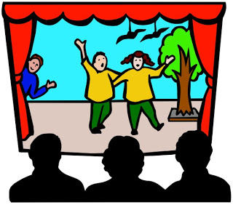
Let’s perform
Notes:
LESSON 5:
Warm up - Begin with a recap of all the rhythms and the structure on body percussion
Explain that Holst’s piece has a special ending called a ‘coda’. Write the following list on the board and have a quick discussion about it
Short scurrying x2
Long scurrying
Random ‘bangs’
Long note (G)
OR…. listen to the end of Mars and ask your class to write down or draw what is happening. Use the last 45 seconds of any version. Continue this lesson using their drawings (or ‘scores’) rather than your list
Splitting back into your two original working groups, challenge each group to interpret the list (or their drawings) using the instruments they already have
Bring the groups back together and hear what they have created. Ask the class to join their efforts together to make one big coda.
Once this is achieved listen to the real thing and follow the list (or their drawings) along.
Finally, add this coda on to the end of the piece you created last week and perform your finished piece to another class.

Slide 29
Lesson 6
Create your own ‘new’ planets piece
Copyright Rachel Leach & BBC
Notes:
Lesson 6:
Activities: Create musical motifs to describe a new planet
Structure these ideas into a piece
Curriculum link: Play and perform in solo and ensemble contexts, using their voices and playing musical instruments with increasing accuracy, fluency, control and expression
Improvise and compose music for a range of purposes using the interrelated dimensions of music

Slide 30


Create your own motifs
Notes:
LESSON 6:
After a quick warm up, explain to your children that Holst didn’t make a musical movement for Earth. Their next task is the make your own version of Earth or even an imaginary planet!
Split the class into smaller working groups. Ask each group to make a list of three things about their chosen planet. These can be descriptions of landscape, or life on the planet or scientific facts. (i.e. for Earth they could have a scientific fact - it is 71% water, or describe life here – i.e. busy, bustling cities full of traffic and people).
Bring the class back together and discuss their ideas. Ask each group to make a musical motif for each of the things on their list. Motif is the term for a short musical idea. It can be a rhythm, a collection of notes or even a sound effect. Encourage your students to keep their motifs short and simple.
Challenge each group to make a short piece from these motifs (just as Holst did with his motifs for Mars). They could use the following questions to help them
What goes first?
What goes last?
Do any of the ideas fit together?
Do the ideas overlap, transform or repeat?
Finally, hear their final pieces. You could even make a concert out of the new planet (group) pieces and the (full class) version of Mars with a backdrop of artwork inspired by the planets!

Slide 31
Create your own piece
• What goes first?
• What goes last?
• Do any of the ideas fit together?
• Do the ideas overlap, transform or repeat?
Notes:
LESSON 6:
After a quick warm up, explain to your children that Holst didn’t make a musical movement for Earth or Pluto (which wasn’t discovered until many years after his piece was written and now has been downgraded to ‘dwarf-planet’ status). Their next task is the make your own version of Earth or Pluto or even an imaginary planet!
Split the class into smaller working groups. Ask each group to make a list of three things about their chosen planet. These can be descriptions of landscape, or life on the planet or scientific facts. (i.e. for Earth they could have a scientific fact - it is 71% water, or describe life here – i.e. busy, bustling cities full of traffic and people).
Bring the class back together and discuss their ideas. Ask each group to make a musical motif for each of the things on their list. Motif is the term for a short musical idea. It can be a rhythm, a collection of notes or even a sound effect. Encourage your students to keep their motifs short and simple.
Challenge each group to make a short piece from these motifs (just as Holst did with his motifs for Mars). They could use the following questions to help them
What goes first?
What goes last?
Do any of the ideas fit together?
Do the ideas overlap, transform or repeat?
Finally, hear their final pieces. You could even make a concert out of the new planet (group) pieces and the (full class) version of Mars with a backdrop of artwork inspired by the planets!

Slide 32
Taking it further – cross-curricular activities
RESEARCH: look into the science of the other planets
LISTENING: Holst did write music for Venus, Mercury, Jupiter, Saturn, Uranus and Neptune. Listen to these pieces and use them as the inspiration for art-work, literacy and music
LITERACY: Write a story or newspaper report about travelling to and landing on one of the planets.
ART: invent and draw a new planet.

