Slide 1
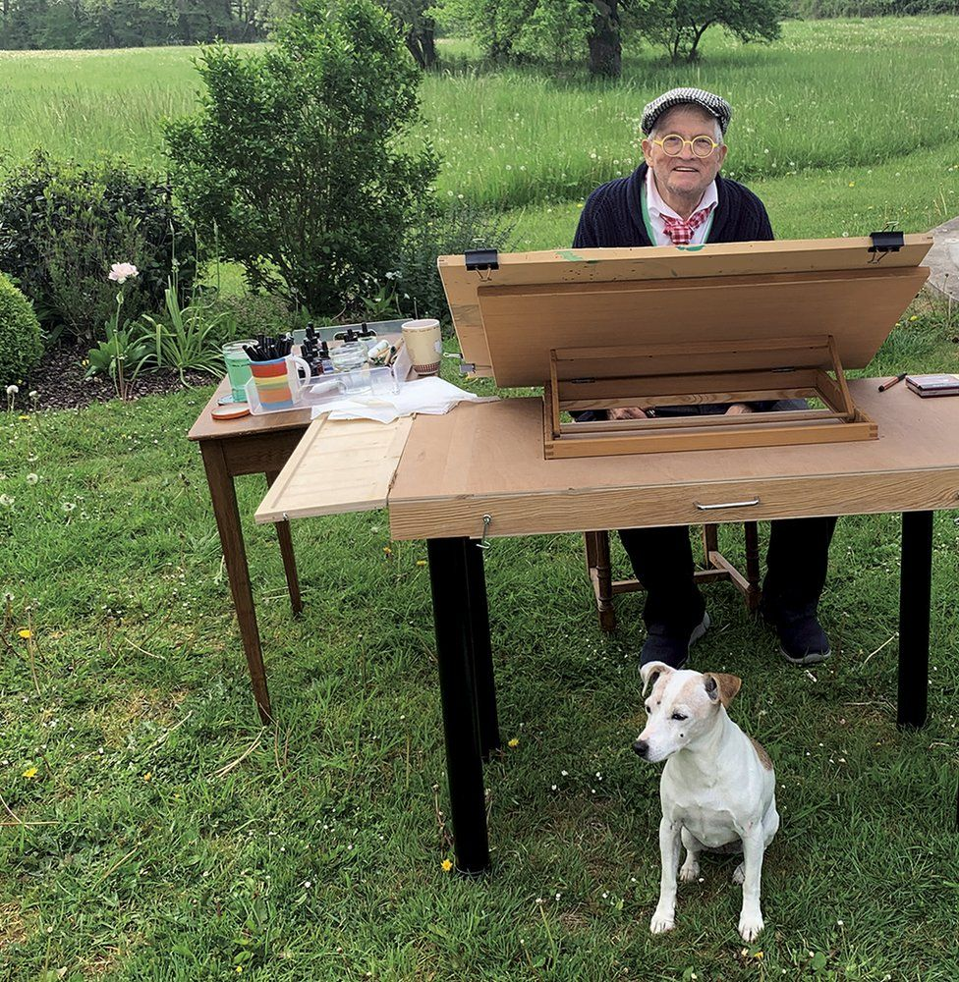
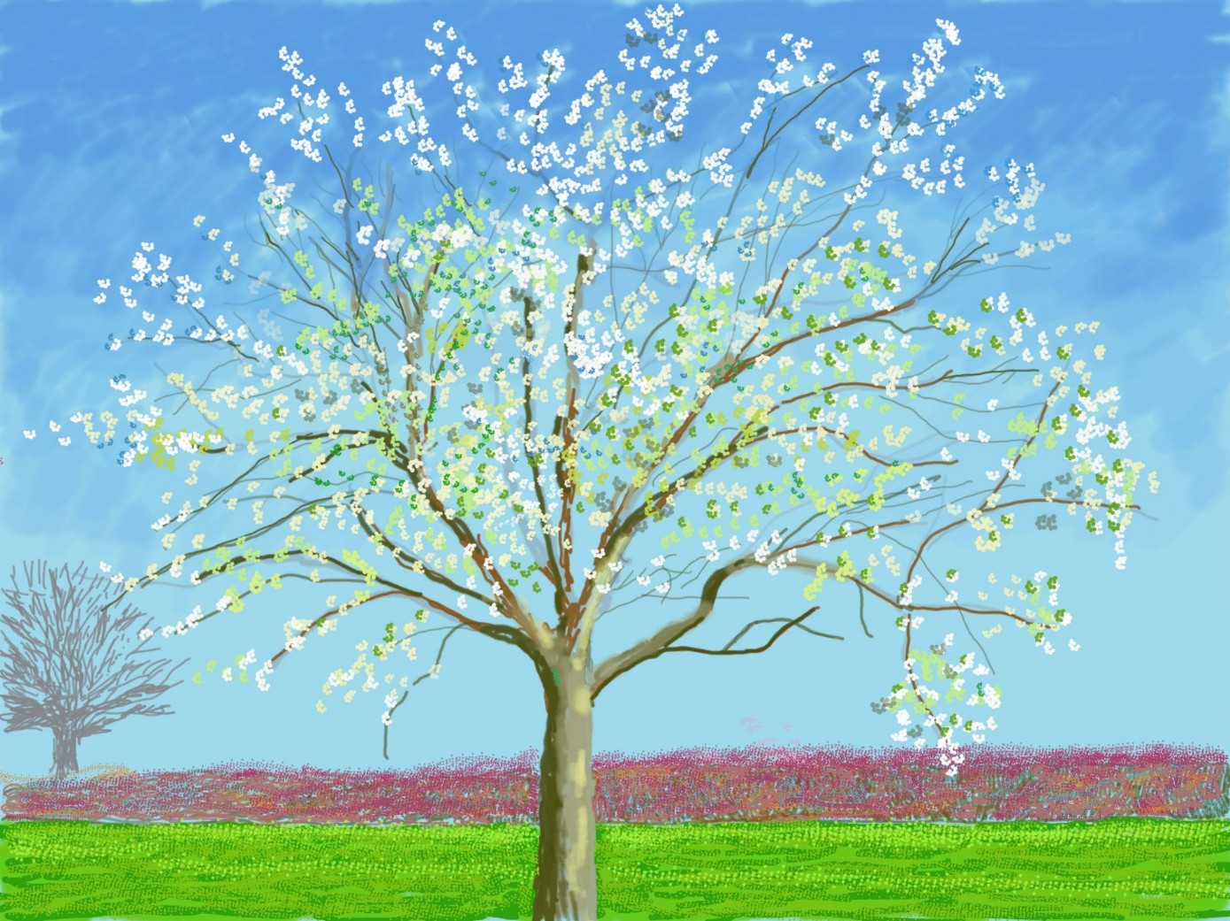
David Hockney’s Spring Art
David Hockney, the famous British artist, is in lock down in his house in Normandy, France with his dog Ruby. He is in the garden most days, drawing the spring awakening on his iPad.

Slide 2
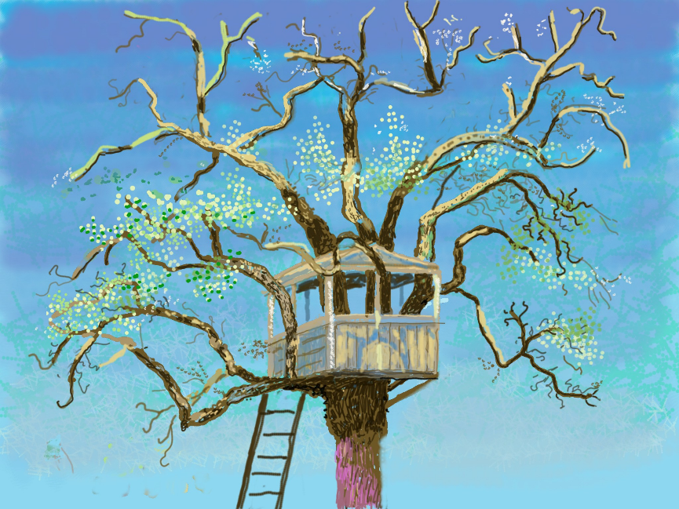
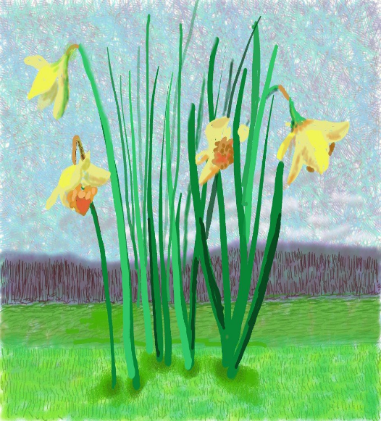

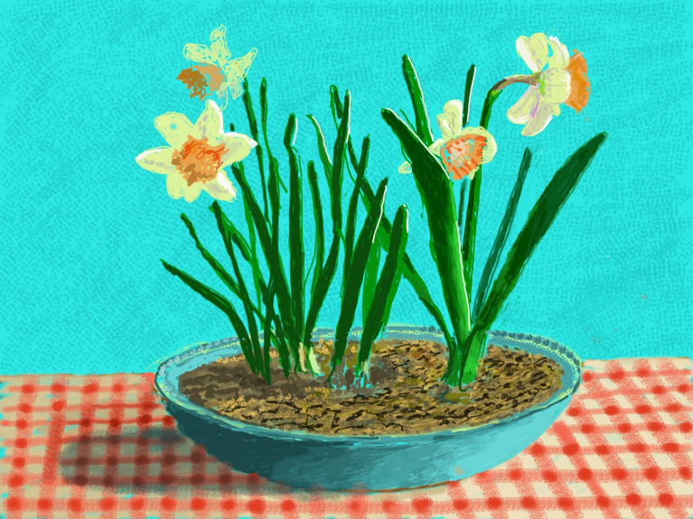
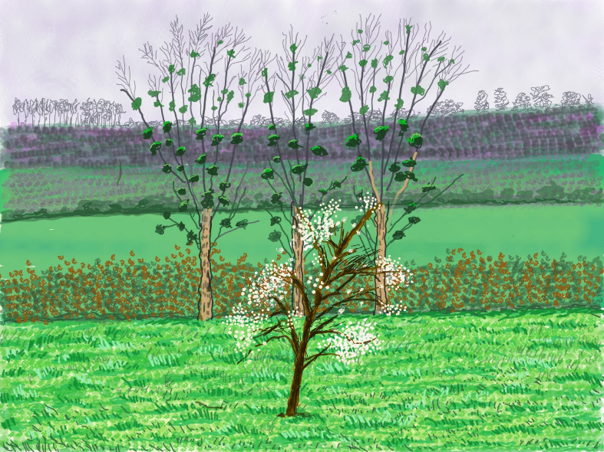
"The only real things in life are food and love in that order, just like our little dog Ruby. I really believe this and the source of art is love. I love life.“ David Hockney.
Which picture do you like best and why?

Slide 3
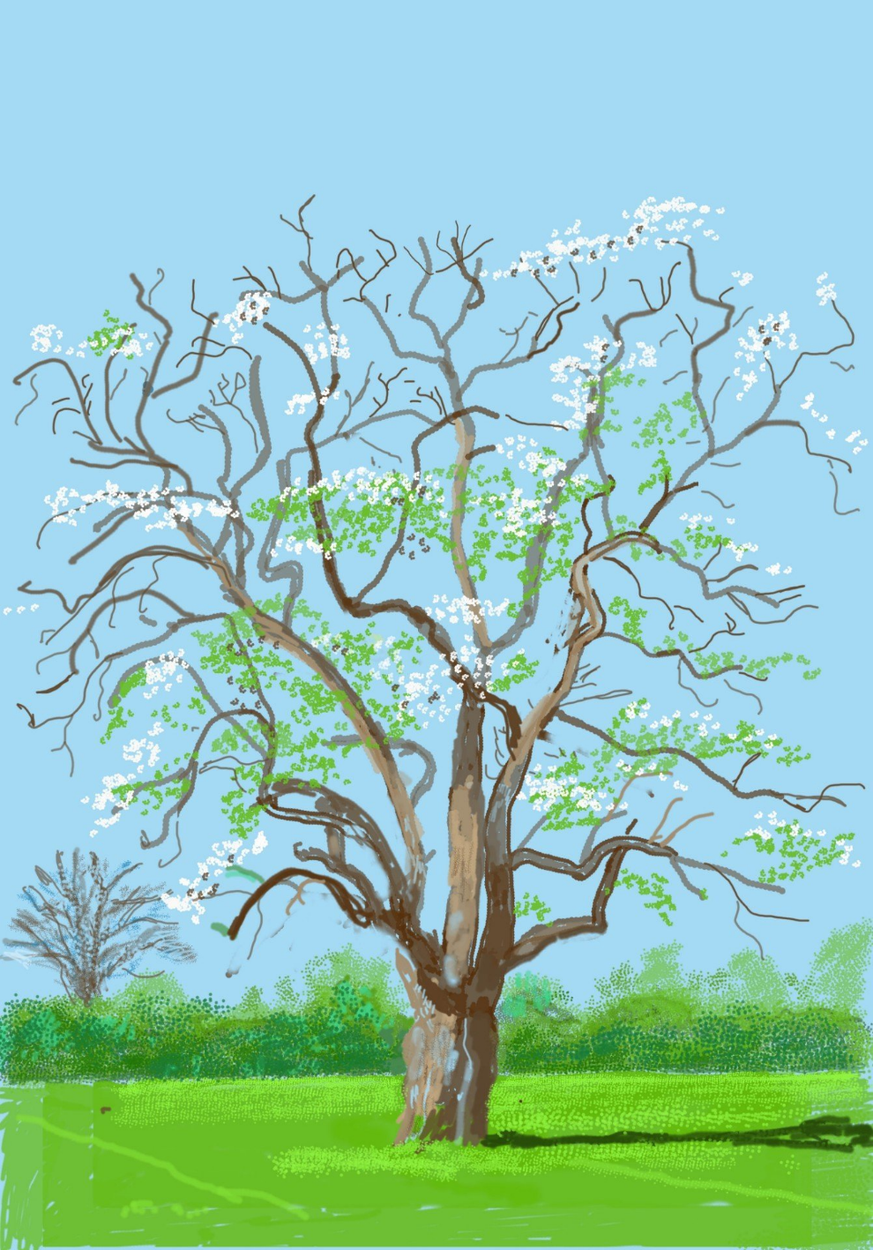
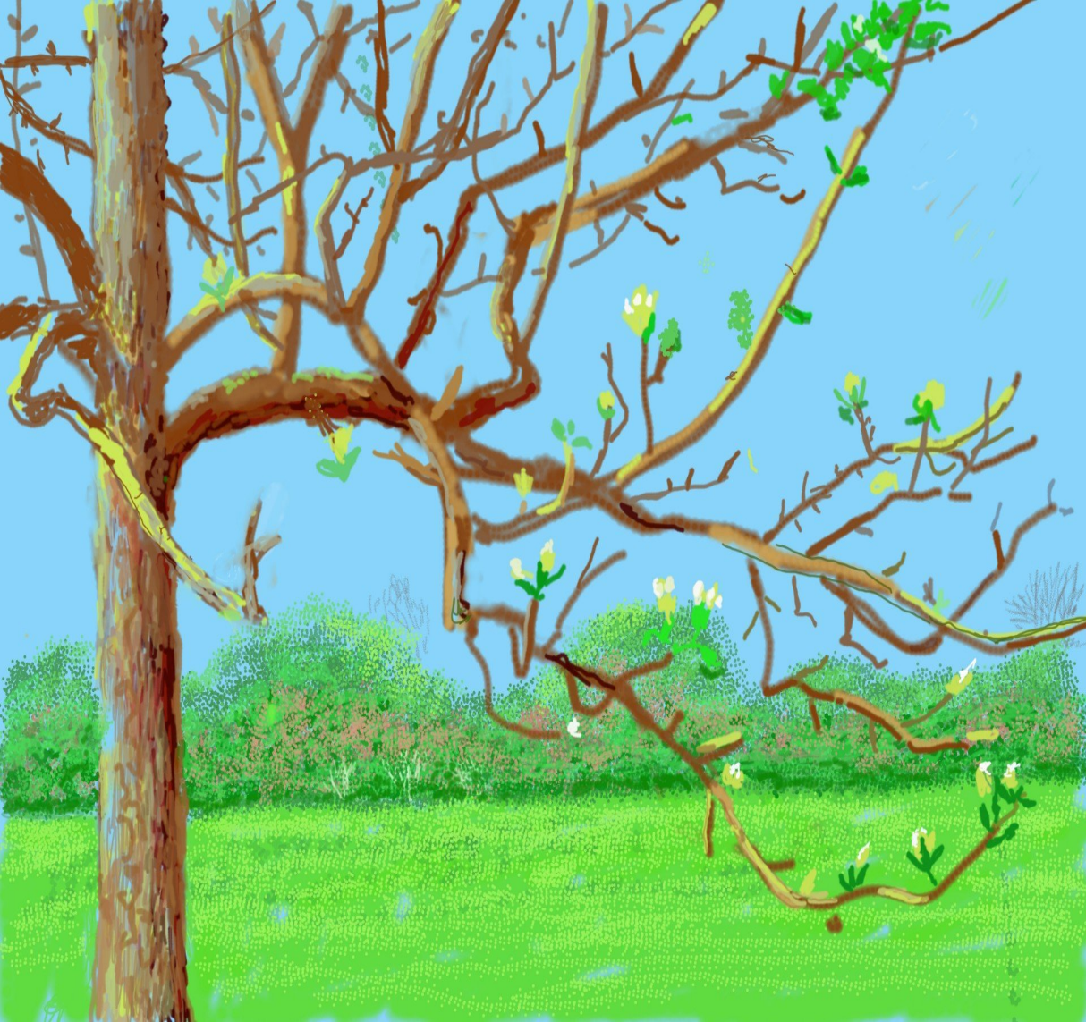

Slide 4

Your task is to recreate one of Hockney’s blossom trees or daffodil pictures. Use paints, pastels, chalks, crayons, collage materials or pencils –any materials that you have at home is fine.
Please email your teachers a photo of your finished art work as we would love to see it.
Have fun!

