Slide 1
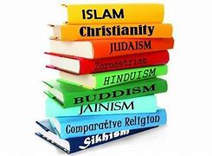
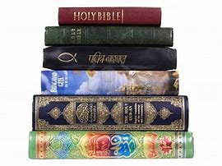
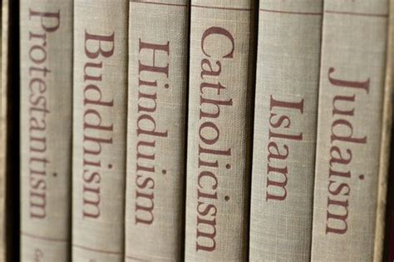
Why do religious books and teachings matter?
Can you think why religious books and stories are important?
Click onto the next slide to find out.

Slide 2

Why do religious books and teachings matter?
tells the story of their faith
teaches them how to live and is a moral guide,
helps them when life is hard

Slide 3
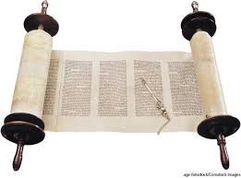
What is this picture showing?
Click on to the next slide to find out.

Slide 4
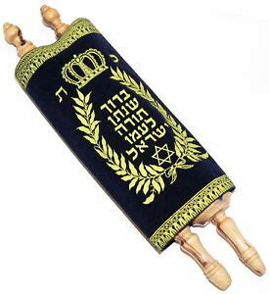
This is the Torah, the Jewish holy book.
Click here to watch the Espresso video to find out how the Torah is treated.
If the link does not work then go to Discovery Education - Espresso – Key Stage 2-RE-Faiths- Judaism – Videos – Shabbat at the synagogue
Log in details
Username student3027
Password hjspup1l
Watch carefully and try and remember 3 different ways the Torah is looked after.

Slide 5
Ways to treat the Torah
Did you spot them?
Kept in the Ark – special cupboard facing towards Jerusalem
Covered with a velvet robe.
Written on parchment by hand in Hebrew
Only touched by the yad, a silver pointer ‘hand’.
Shown to the worshippers before putting it back it the Ark
See the next slide for your activity.

Slide 6
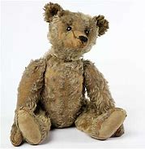
What is your most precious belonging?
How do you protect it and keep it safe?
Any special rules?
Does it live in a special place in your house?
How do you treat it?
Write a paragraph explaining how you treat your most precious belonging and email a photo to your teacher. We would love to see it!

